Slide 1

The Technology Value Stream Carmen Mendoza CSD380

Slide 2
Objective
Understand Lead Time
Processing Time
DevOps Goals

Slide 3

What is the Technology Value Stream?

Slide 4
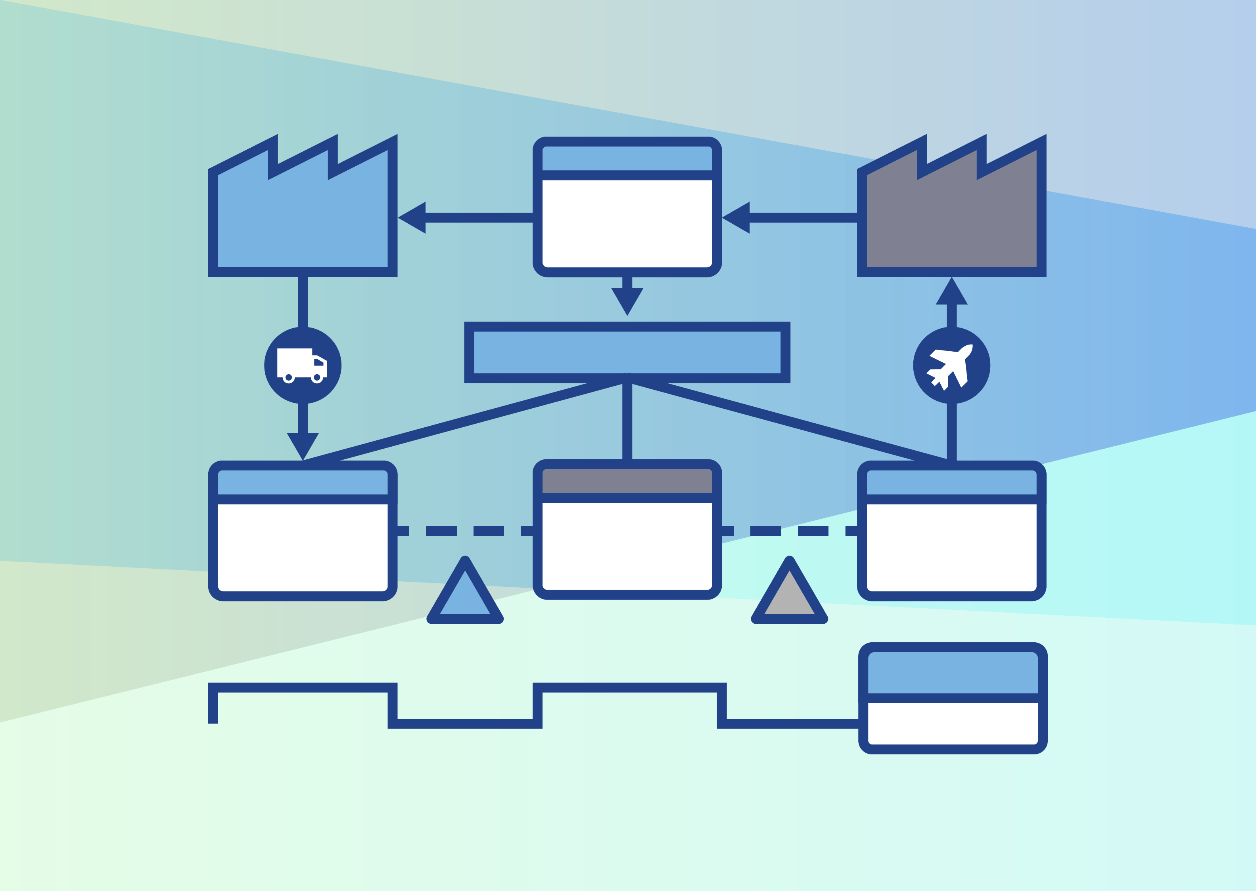
Technology Value Stream
The Technology Value Stream is "the process required to convert a business hypothesis into a technology-enabled service or feature that delivers value to the customers".
Kim, G., Humble, J., Debois, P., & Willis, J. (2021). The DevOps Handbook (p. 9). It Revolution.

Slide 5
Technology Value Stream
It includes requirements gathering, design, development, testing, deployment, and maintenance.
Goal: to improve speed and quality of delivery through collaborations and continuous feedback.

Slide 6
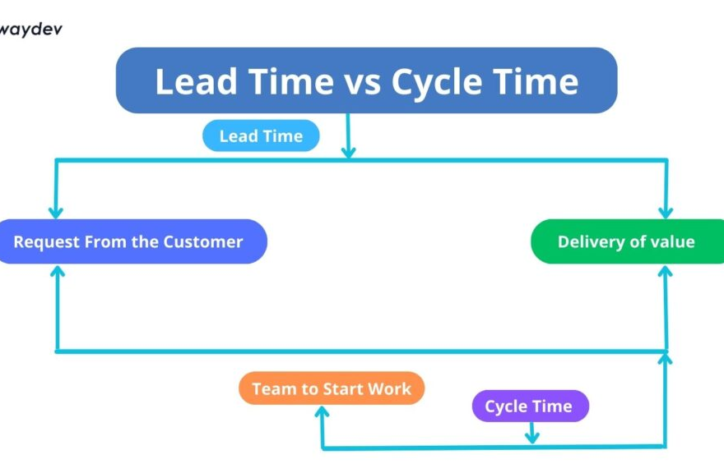
Lead Time vs. Processing Time
Lead Time: The total time from the start of a process to its completion.
This can include wait times, approvals, and handoffs.
Processing Time: The time spent performing the work.
This can be coding, testing, and deploying.

Slide 7
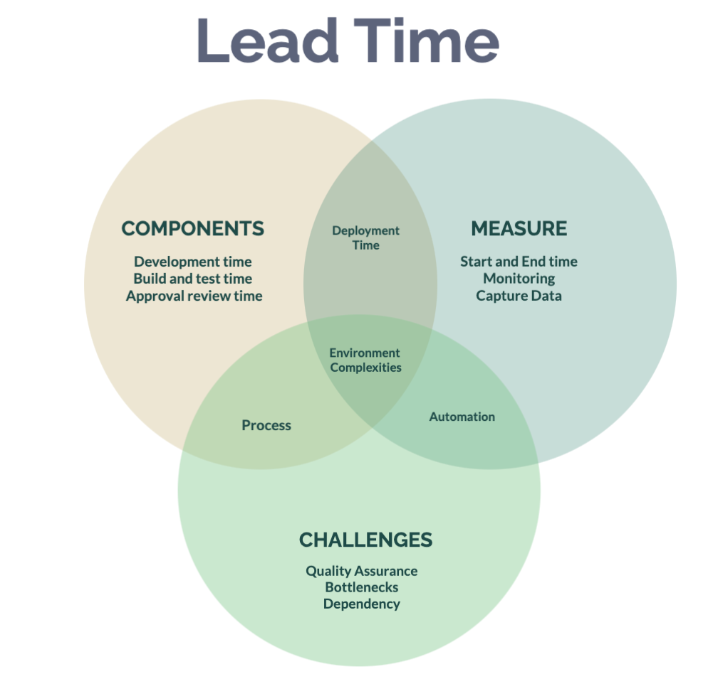
Long Deployment Lead Times Common Scenario:
Long deployment lead times, can be caused by
Scarce integration test environments
Manual testing and deployment
Poor communication and collaboration
Long test and production environments
Deployment lead times can stretch to months or quarters

Slide 8
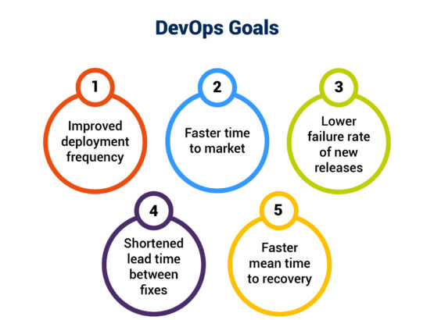
DevOps Goal:
To reduce deployment lead time from months to minutes
This can be done by:
Automation of testing and deployment
Continuous Integration and delivery
This will impact by having higher reliability, faster innovation, and continuous improvement

Slide 9

Benefits of The Technology Value Stream
Higher customer satisfaction
Fewer rollbacks
Faster delivery
Increase productivity and team morale
Reduced costs

Slide 10

Conclusion
The Technology Value System is crucial for delivering value efficiently.
DevOps practices can make long manual processes faster.
Businesses and organizations can reduce lead time and optimize the value stream as a strategic advantage.

Slide 11
References:
Kim, G., Humble, J., Debois, P., & Willis, J. (2021). The DevOps Handbook (2nd ed.). IT Revolution.
(2023, February 6). Value Stream Management. TechTarget. https://www.techtarget.com/searchcio/definition/value-stream-management
(2024, October 6). Lead Time vs. Cycle Time: What’s the Difference? ISIXSIGMA. https://www.isixsigma.com/methodology/lead-time-vs-cycle-time-whats-the-difference

